Slide 1

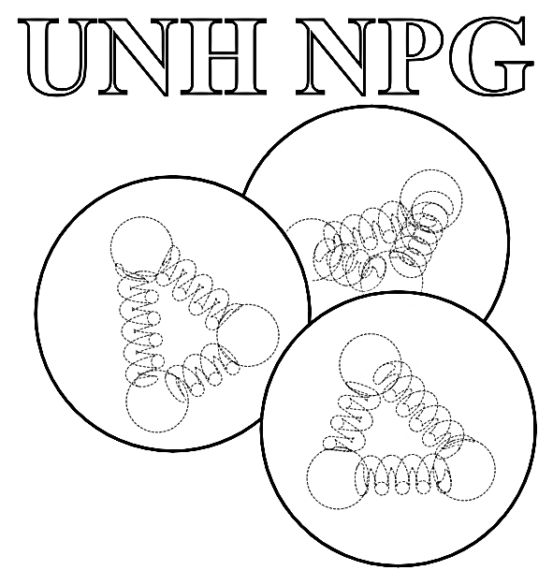
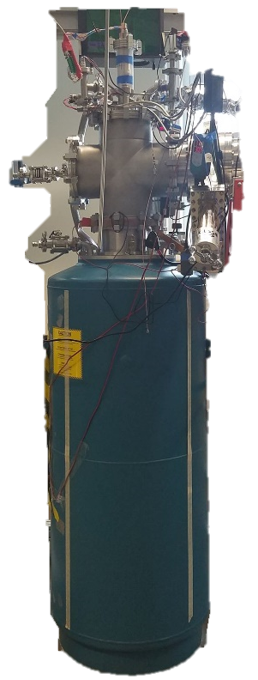
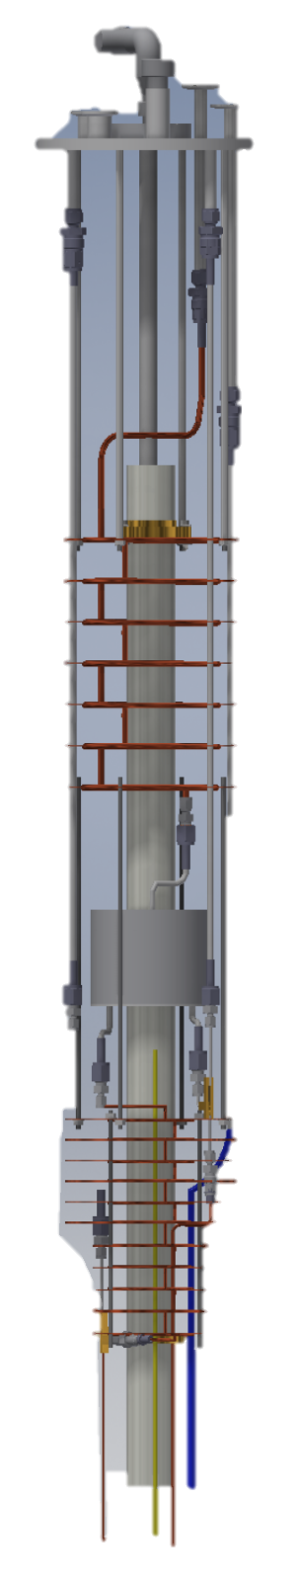
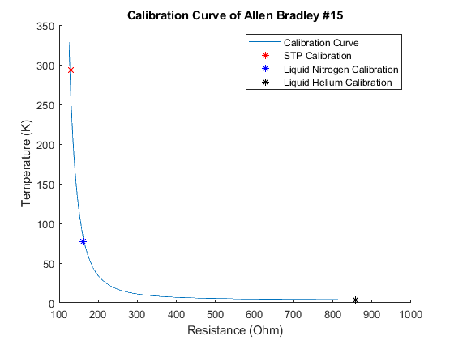
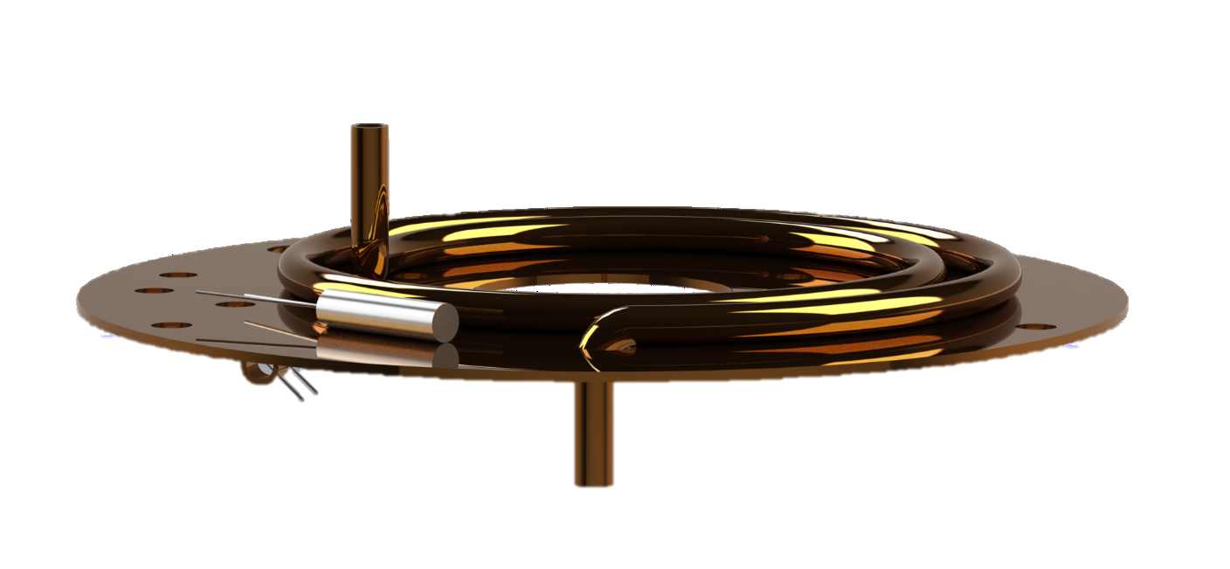
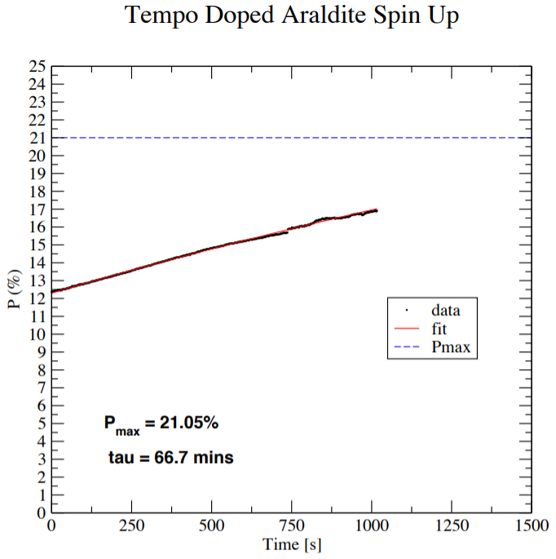
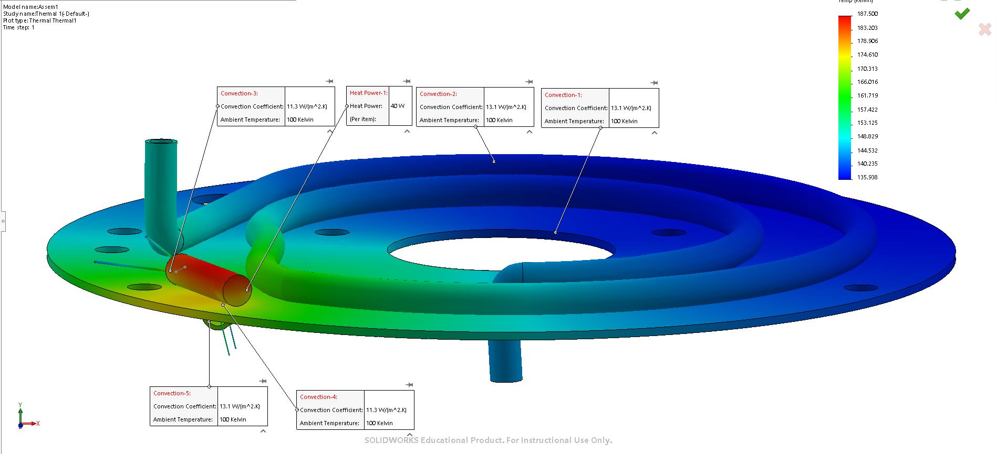
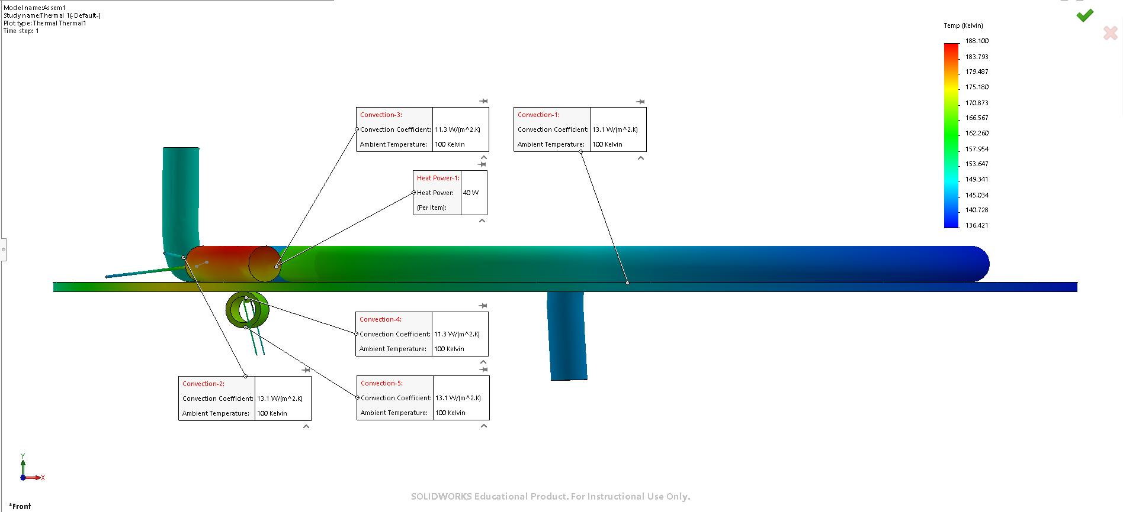
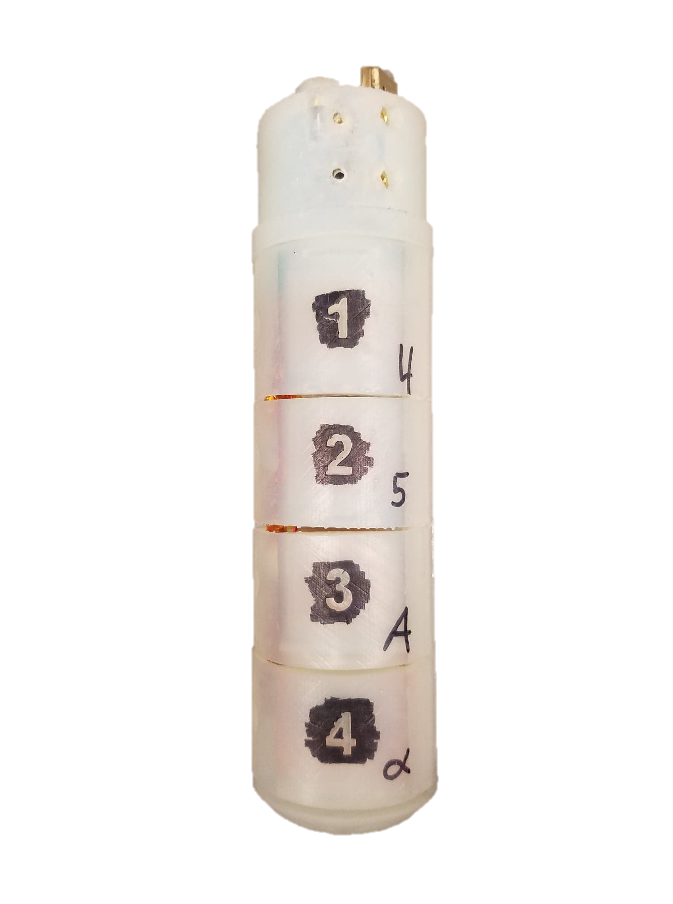
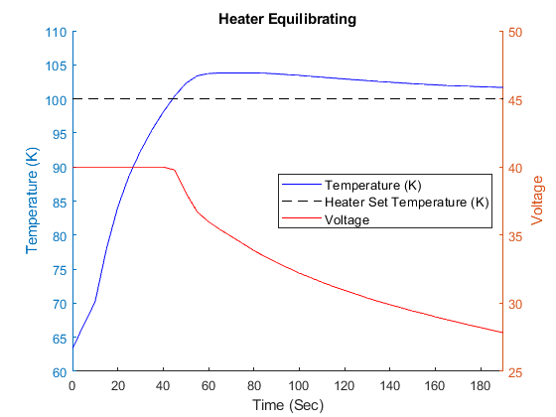
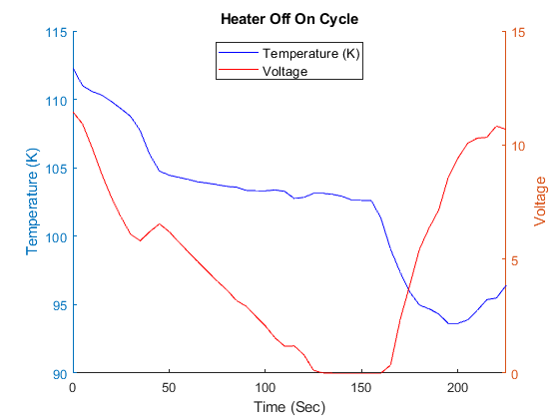
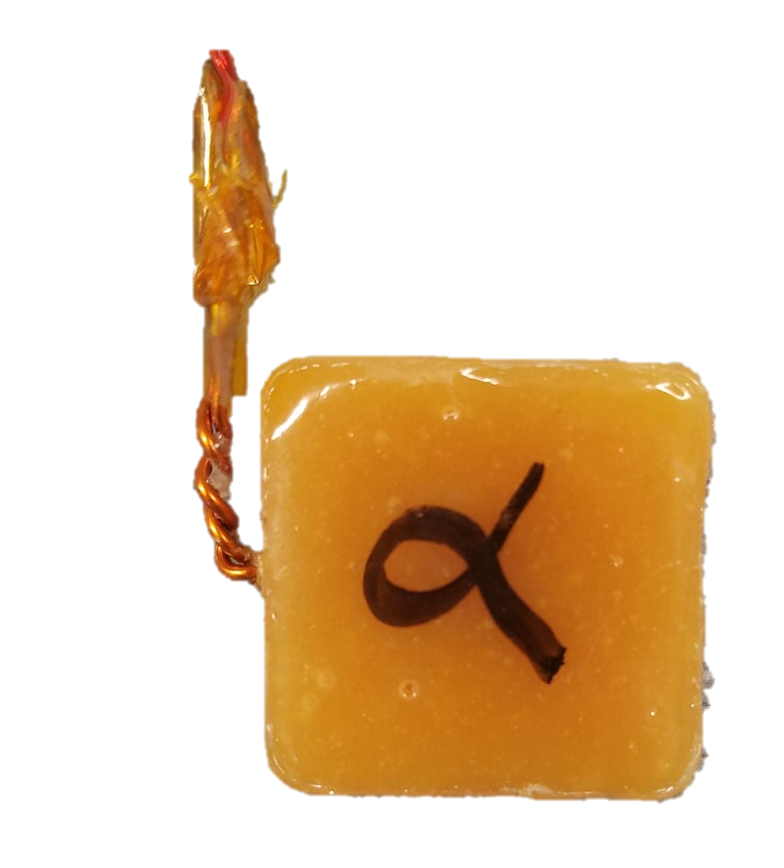
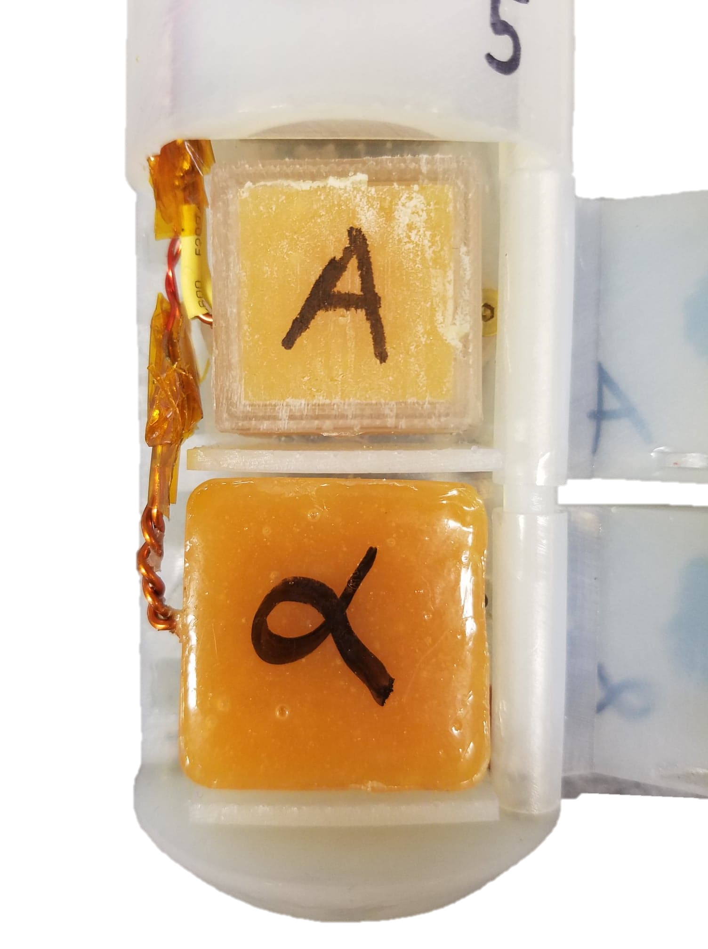
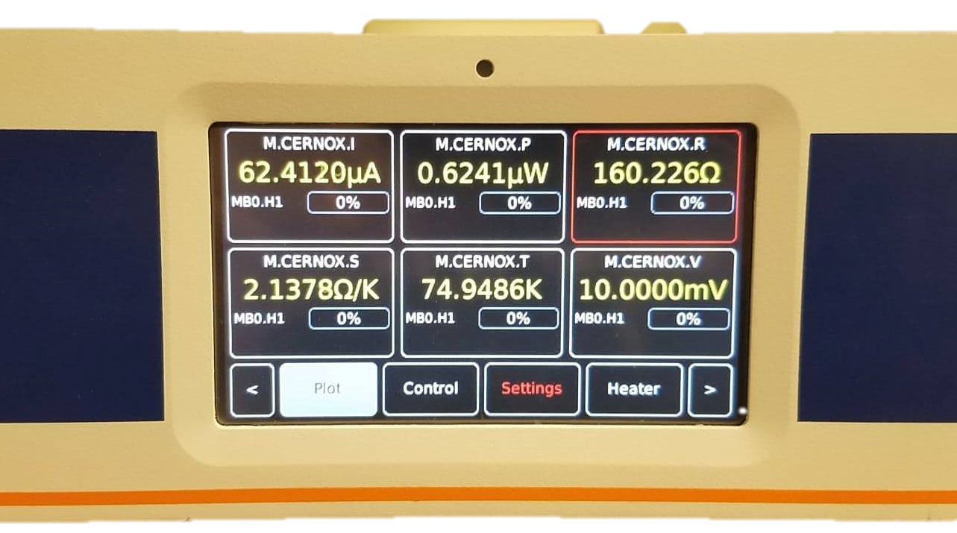
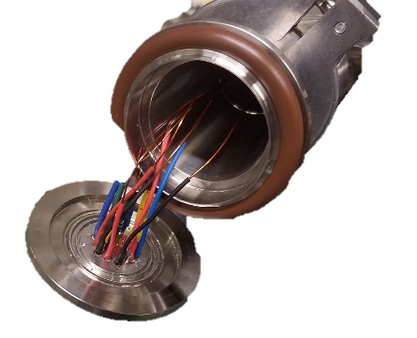
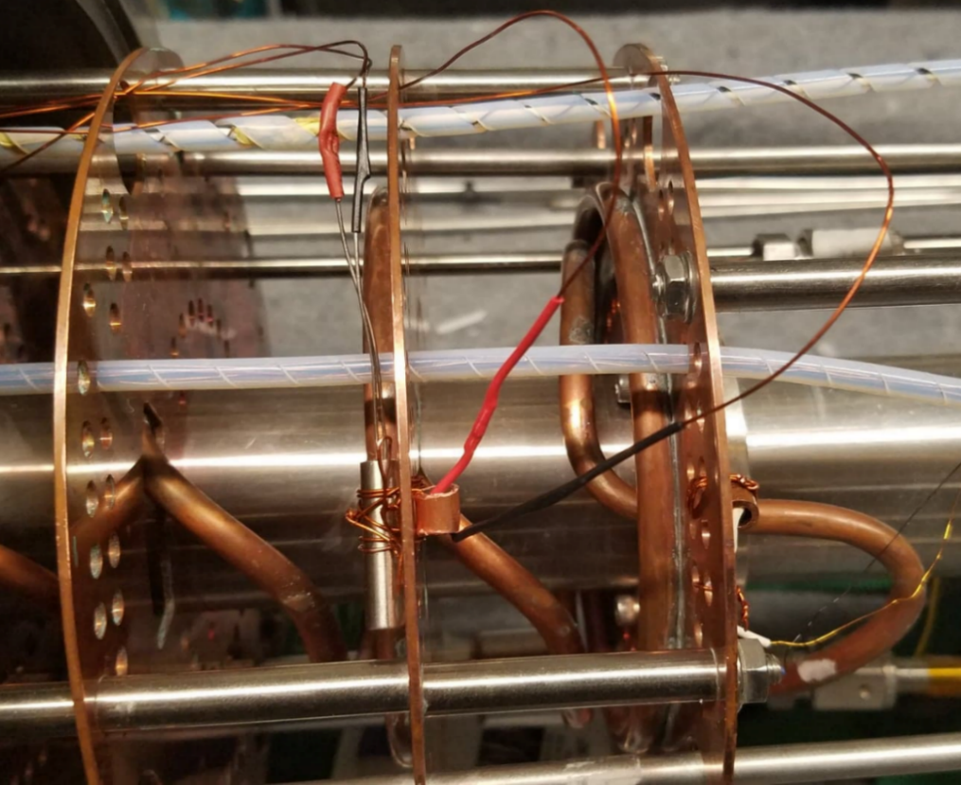
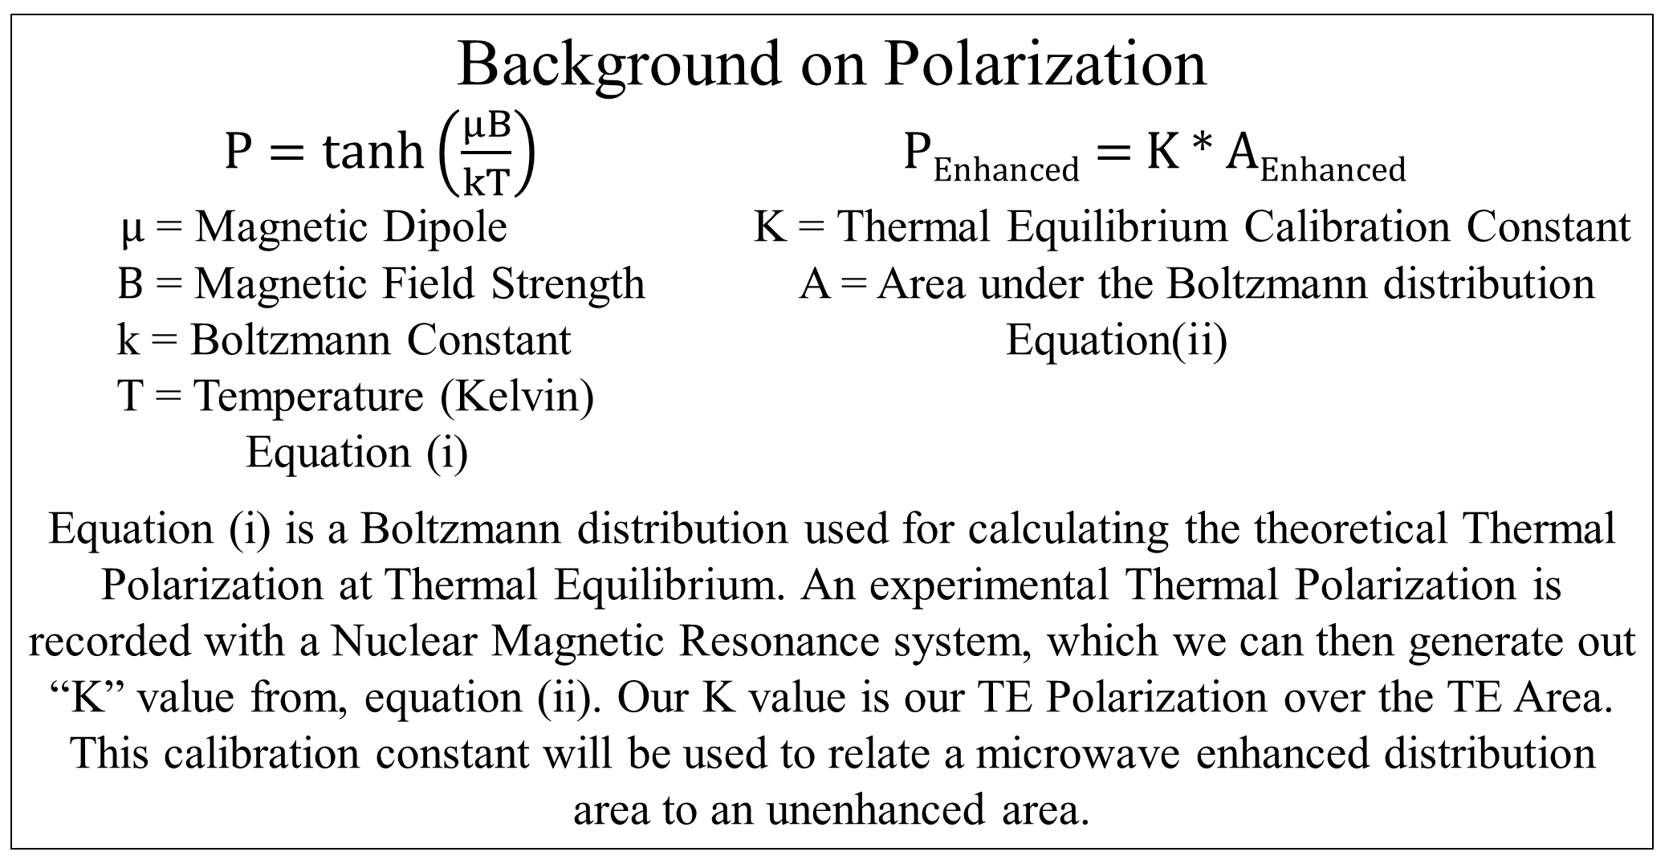

Polarization of TEMPO Doped Araldite and
Vaporization of Liquid Helium
Thomas Collins
Advisor: Professor Karl Slifer
Background
My research at Professor Karl Slifer’s Polarized Target Lab was to test polarizable proton rich target material for use in our DNP polarizer (left side). Secondly, to implement a system to vaporized liquid helium venting from the fridge space (right side). A deconstruction of the DNP polarizer is seen below.
Motivation
Araldite Epoxy doped with TEMPO has been found to be a suitable target material for Dynamic Nuclear Polarization. A maximum proton polarization value of 21.05% percent has been achieved with a magnetic field of 4.998T and a temperature of about 1.2 K. The simple process of making targets that are free form, quickly reproducible, and relatively harmless in production make it an attractive option for DNP.
Magnet and Fridge Assembly
Low Temperature Thermometry
$$T[K]=a+be^{\left(\frac{1000}{R[Ω]}c\right)}$$
a = 2.37
b = 0.66
c = 0.78
Fridge Assembly
Background on Polarization
$P=\tanh\left(\frac{μB}{kT}\right)$ P_{Enhanced} = K * A_{Enhanced}
$μ$ = Magnetic Dipole K = Thermal Equilibrium Calibration Constant
$B$ = Magnetic Field Strength A = Area under the Boltzmann distribution
k = Boltzmann Constant Equation(ii)
T = Temperature (Kelvin)
Equation (i)
Equation (i) is a Boltzmann distribution used for calculating the theoretical Thermal Polarization at Thermal Equilibrium. An experimental Thermal Polarization is recorded with a Nuclear Magnetic Resonance system, which we can then generate out “K” value from, equation (ii). Our K value is our TE Polarization over the TE Area. This calibration constant will be used to relate a microwave enhanced distribution area to an unenhanced area.
An Allen Bradley Resistor was used to calculate the temperature on the adjacent side of the heating baffle. Previous to instillation a calibration must occur with the given equation and values listed above. These values were predetermined by Slifer Lab. Allen Bradley Resistors are Negative Temperature Coefficient resistors, meaning they exhibit an exponential increase in resistance in low temperatures.
Heating Cartridge and Thermometry SOLIDWORKS rendering of the heating cartridge and Allen Bradly thermometry assembly. Located On the second baffle above the separator.
Thermal Analysis of the Heating Cartridge
Post cooldown, a thermal analysis of the heating cartridge was done to observe its effect on the baffle and copper coil tubing. The heating of the venting gaseous helium was critical for the DNP system to ensure the Viton and Teflon O-rings did not fail due to freezing temperatures. In this analysis, the ambient temperature was chosen to be 100K, and the heater power is set to 40W. These environmental characteristics and the thermal coefficients for each part ensured an accurate representation.
Tempo Doped Araldite Spin Up
Post cooldown an analysis of our target polarization was done to determine our maximum polarization. Through analysis of our cryostat environment, magnetic field strength and other factors we determined that our polarization would have reached a maximum of 21.05% if our study had continued. Although 21.05% polarization is an incredible achievement, we have yet to reach the 80% theoretical polarization stated in the literature. Additionally, a comparison between theoretical and experimental tau shows that we are taking too long to reach our P_{max}, we should expect to see a value between 25-30min.
Tempo Doped Araldite Target
Target stick containing the A and Alpha target in 3rd and 4th cups. Located on the end of the target ladder on the bottom of the fridge.
Thermal Results
The following graphs consist of experimental data collected during the March 2019 Cooldown.
P_{max} = Maximum Polarization
tau = Experimental Time Constant
Tempo Doped Araldite Targets
Mercury iTC
A Mercury iTC is a cryogenic programmable intelligent temperature controller. This was used to monitor temperature and resistance, while controlling the heating cartridge though a set temperature or heat flow (%).
Heating Element
19 Pin Connection
A D9 connector ran from the back of the Mercury iTC to the 19 pin connector. A 19 pin connector was used for electrical connections between the lab space and the vacuum environment.
Heating Element
The heating cartridge and Allen Bradley resistor separated by a copper baffle. Wiring consisted of magnet wire and spade clips connections.
Stable titroxyl radical Tempo was mixed with 1:200 part Araldite Epoxy. This allowed us to create free form polarization targets with a magnet wire coil centered in the material. The small Tempo admixture provides the paramagnetic radicals necessary for dynamic nuclear polarization technique.
Figure (i) is a graphical visualization of the heater equilibrating to a set point temperature of 100 K.
Figure (ii) shows the heater turning off from an set temperature, once 150 sec pass the heater is turned on again.
Future Works
Integrate the heating cartridge into the preexisting LabVIEW data stream.
Investigate new methods of regulating the fridge temperature.
Investigate and improve DNP System to achieve 80% Polarization
Reference
Noda, Yohei. "Thermosetting polymer for dynamic nuclear polarization:Solidification of an epoxy resin mixture including TEMPO." Elsevier. 09 Dec. 2014. <https://reader.elsevier.comAE/reader/sd/pii/...>.
Acknowledgements
A huge thank you to Karl Slifer, Elena Long, David Ruth, Nathaly Santiesteban, and all the members of Slifer and Long Lab.

